Slide 1
Michael Allen Sprint #6 Review
Initial Findings & Hypothesis of
US Housing Prices

Slide 2
Game Plan
1. Read into R a CSV file Containing Zillow’s US Housing Sales Prices by County
2. Use R to Perform Initial Exploratory Analysis
3. Write a Script to Demonstrate and Calculate the Various Statistical Concepts:

Slide 3
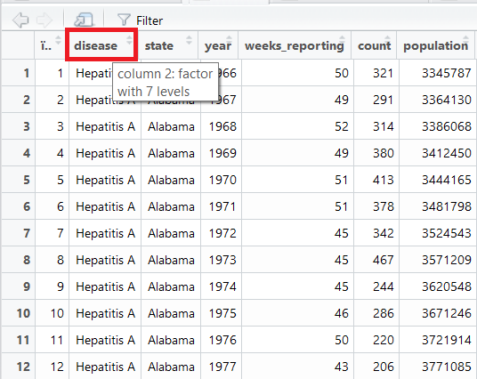
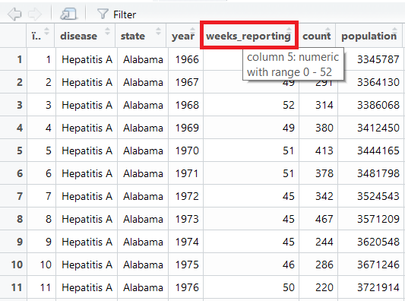
Use the Filter Tools (Mouse Over) to Discover Ranges and Such

Slide 4
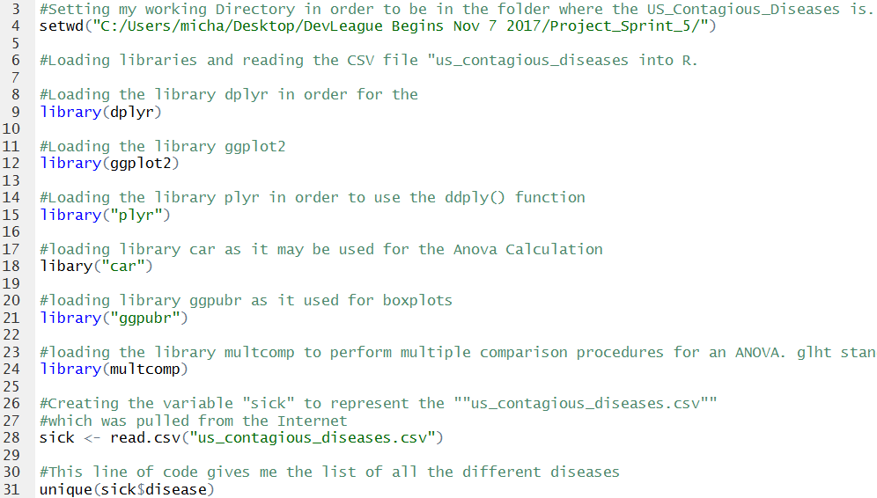
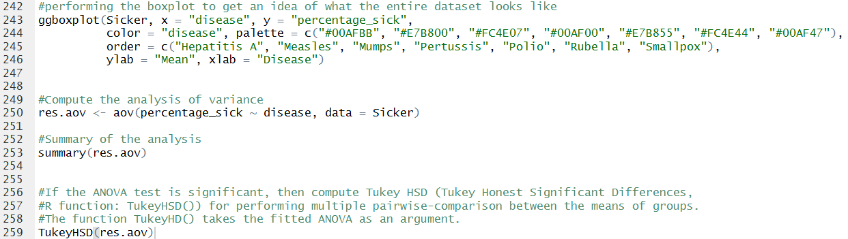
Create a Script in R to Perform Various Exploratory Analysis

Slide 5
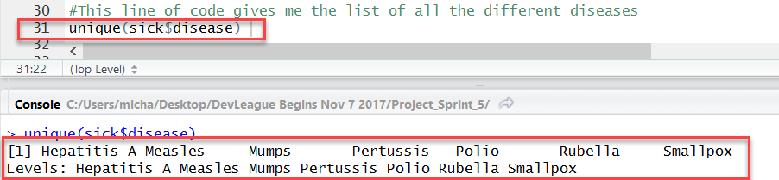
Utilize the “Unique” Command to Discover Column Variables

Slide 6
Viewing the Highest Sick Percentage after Calculation

Slide 7
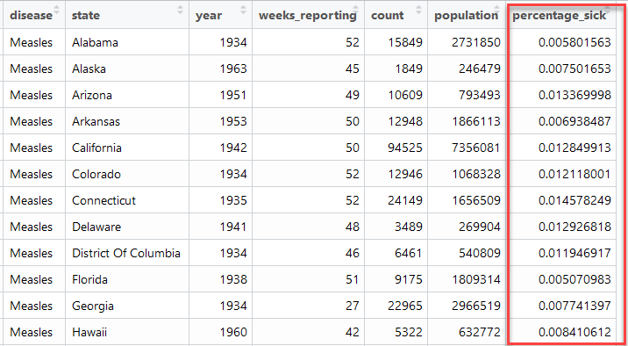
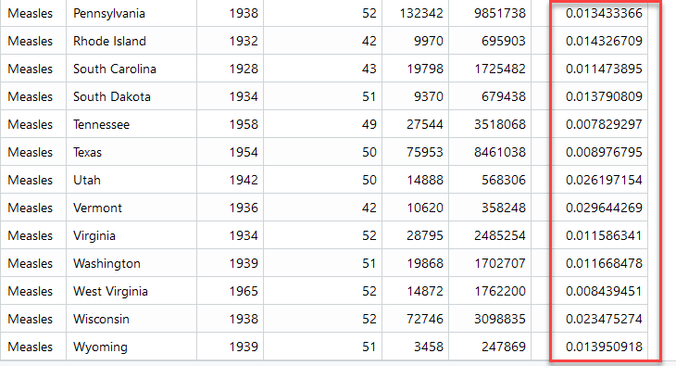
Calculating Each State’s Highest Percentage of Being Sick

Slide 8
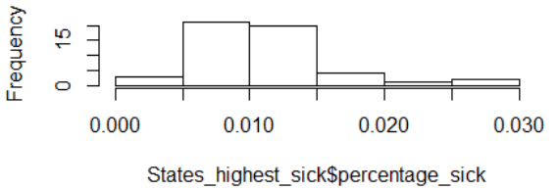
Calculating the Mean for All States for the Highest Percentage Sick
And Histogram

Slide 9
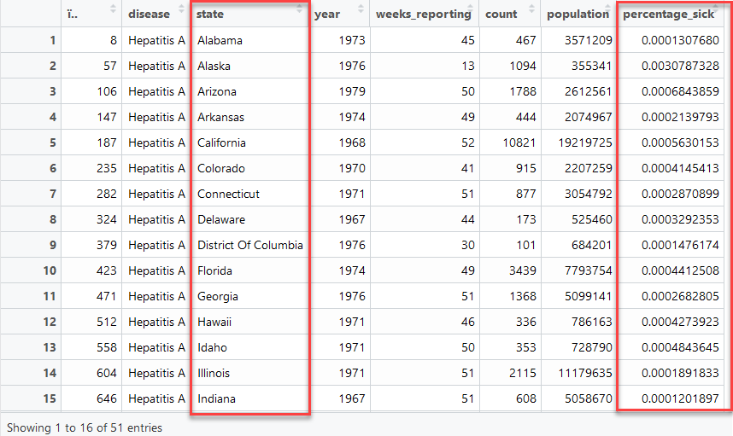
Calculate Specific Disease per State by the Highest Percentage Sick

Slide 10
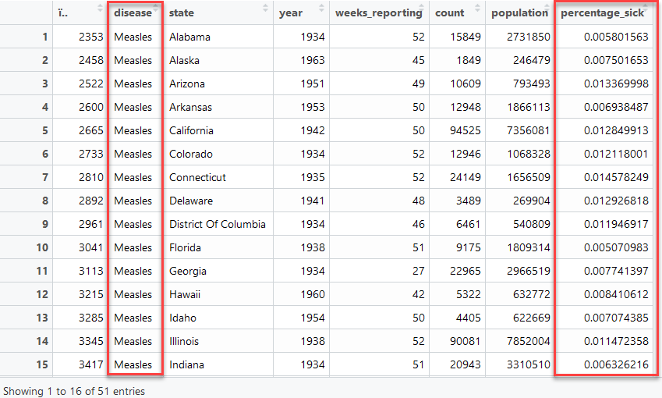
Calculate Specific Disease per State by the Highest Percentage Sick

Slide 11
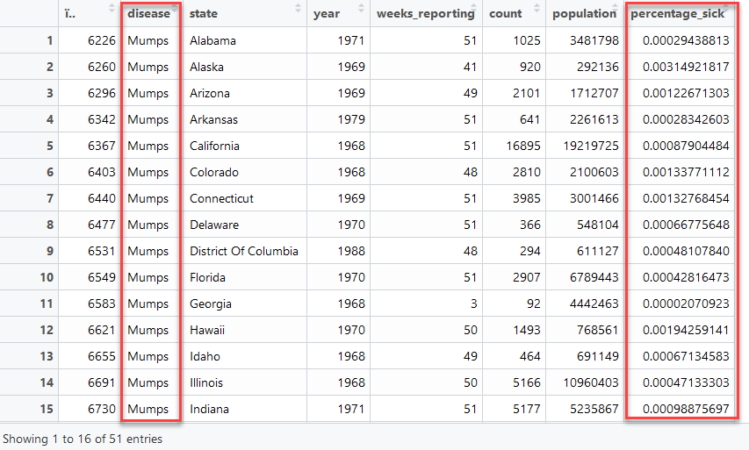
Calculate Specific Disease per State by the Highest Percentage Sick

Slide 12
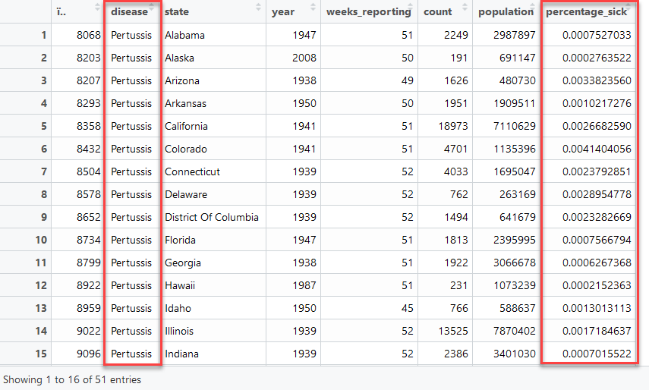
Calculate Specific Disease per State by the Highest Percentage Sick

Slide 13
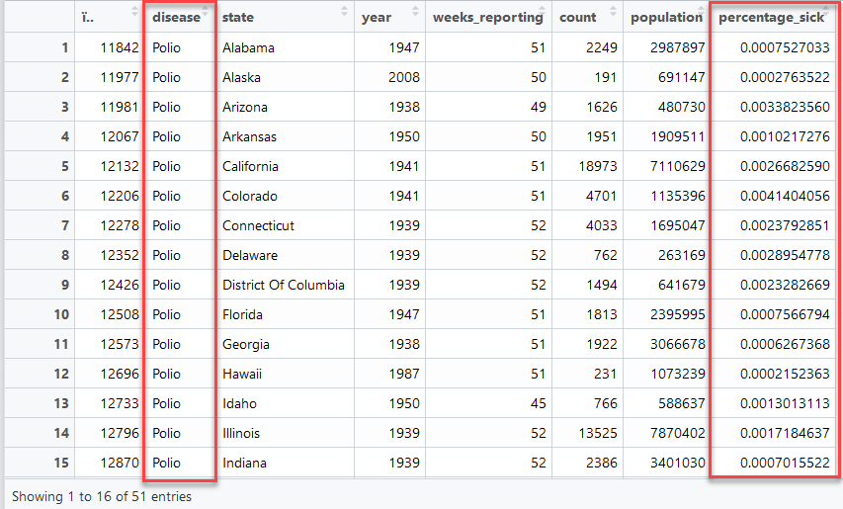
Calculate Specific Disease per State by the Highest Percentage Sick

Slide 14
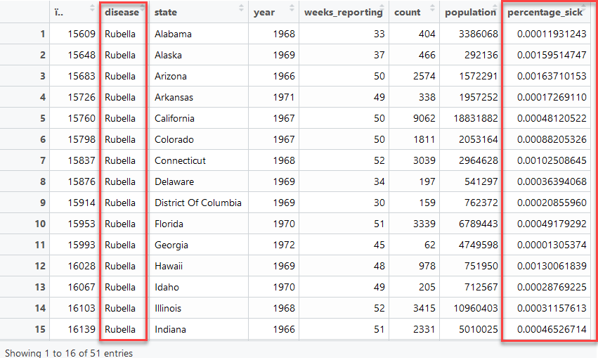
Calculate Specific Disease per State by the Highest Percentage Sick

Slide 15
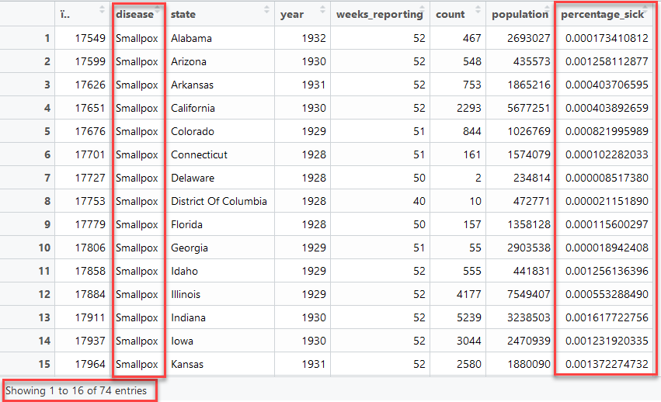
Calculate Specific Disease per State by the Highest Percentage Sick

Slide 16
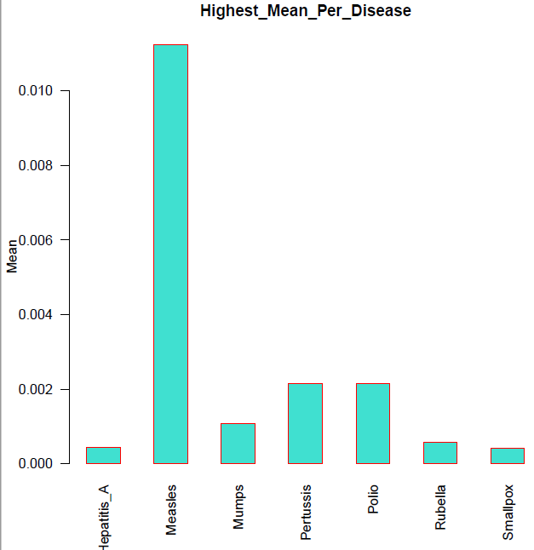
Highest Mean Per Disease

Slide 17
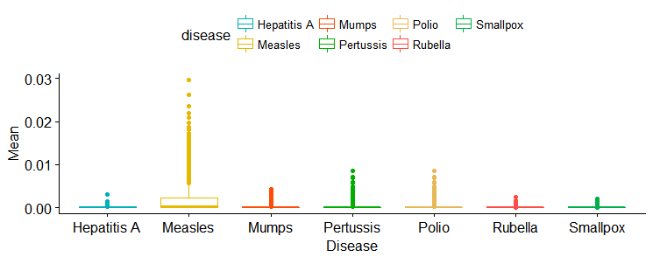
Parameters of the Boxplot of “Entire” Dataset

Slide 18
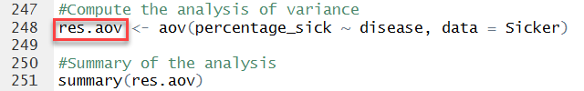
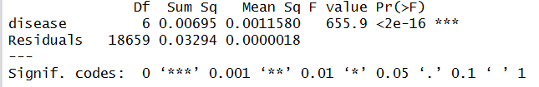
Analysis of Variance - ANOVA

Slide 19
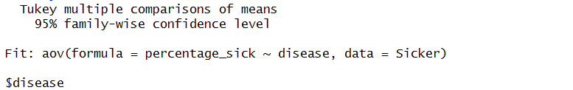
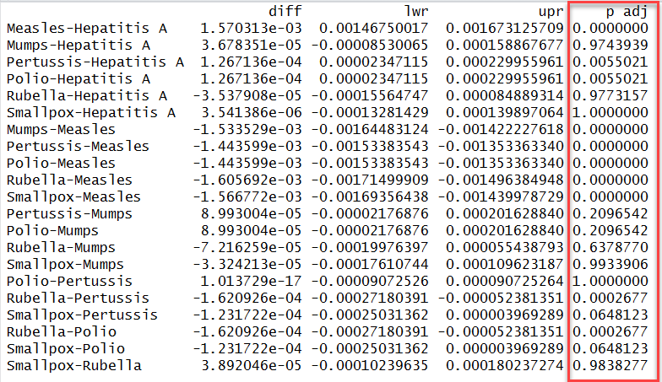
Analysis of Variance - ANOVA

Slide 20
Thank you

